Slide 1
Arrays
Fixed-Size Sequences of Elements
0
1
2
3
4
…
…
…
…
…
SoftUni Team
Technical Trainers
Software University
http://softuni.bg

Slide 2
Table of Contents
Definition
Operations
Array Iteration
For-in and For-of loops

Slide 3
Have a Question?
sli.do
#tech-fund

Slide 4
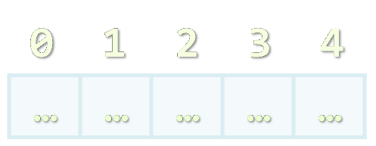
Arrays in JS
Definition and Simple Usage

Slide 5
What are Arrays?
In programming, an array is a sequence of elements
We can store multiple values in one variable
Elements are numbered from 0 to length-1
Arrays have variable size (Array.length) can be resized (unlike C# / Java)
0
1
2
3
4
Element index
Array of 5 elements
…
…
…
…
…
Element of an array

Slide 6
Creating Arrays
Creating an array of numbers:
Accessing array elements by index:
Assigning values to the array elements:
We are creating an Array using the literal [ ]
let numbers = [1, 2, 3, 4, 5];
let names = [];
The [n] operator accesses elements by index
console.log(numbers[0]); // 1
The length holds the number of array elements
numbers[3] = numbers[1] + numbers[2];
console.log(numbers.length); // 5
console.log(numbers); // [1, 2, 3, 5, 5]

Slide 7
Problem: Sum First and Last Array Elements
You are given array of strings holding numbers
Calculate and print the sum of the first and the last elements
20
30
40
5
10
60
15
2
4
function sumFirstAndLast(arr) {
console.log(Number(arr[0]) + Number(arr[arr.length - 1]));
}
Check your solution here: https://judge.softuni.bg/Contests/1243/Arrays-Lab

Slide 8
Days of Week – Example
The days of week can be stored in array of strings:
let days = [
"Monday",
"Tuesday",
"Wednesday",
"Thursday",
"Friday",
"Saturday",
"Sunday"
];
Index | Value
days[0] | Monday
days[1] | Tuesday
days[2] | Wednesday
days[3] | Thursday
days[4] | Friday
days[5] | Saturday
days[6] | Sunday

Slide 9
Problem: Day of Week
Write a program which receives a number and prints the corresponding name of the day of week (in English).
If the number is not a valid day, print "Invalid day!"
3
Wednesday
33
Invalid day!
6
Saturday
-3
Invalid day!
Check your solution here: https://judge.softuni.bg/Contests/1243/Arrays-Lab

Slide 10
Solution: Day of Week
function dayOfWeek(day){
let days = [ "Monday", "Tuesday", "Wednesday", "Thursday", "Friday", "Saturday", "Sunday" ];'
if (day >= 1 && day <= 7)
console.log(days[day - 1]);
else
console.log("Invalid day!");
}
The first day in our array is on index 0, not 1.
Check your solution here: https://judge.softuni.bg/Contests/1243/Arrays-Lab

Slide 11
Arrays of Different Types
// Array holding numbers
let numbers = [10, 20, 30, 40, 50];
// Array holding strings
let weekDays = ['Monday', 'Tuesday', 'Wednesday',
'Thursday', 'Friday', 'Saturday', 'Sunday'];
// Array holding mixed data
let mixedArr =
[20, new Date(), 'hello', {x:5, y:8}];

Slide 12

Operations
Basic array operations and printing

Slide 13
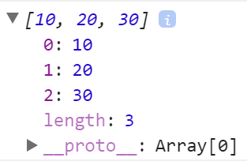
Simple Usage
Replace an element value:
Check if the array contains the specified element:
let arr = [10, 20, 30];
arr[0] = 5; // Elements can be modified
console.log(arr); // [5, 20, 30]
console.log(arr.includes(20)); // true
console.log(arr.includes(0)); // false

Slide 14
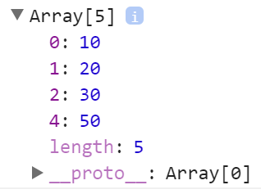
JS Arrays and Invalid Positions
let nums = [10, 20, 30];
nums[4] = 50; // Will resize the array
console.log(nums); // [10, 20, 30, ,50]
console.log(nums.length); // 5
console.log(nums[3]); // undefined
console.log(nums[-5]); // undefined
nums[-5] = -5; // Will not resize the array console.log([nums[-5], nums.length]); // [-5, 5]

Slide 15
Pushing Elements in Array
The right way to add elements in a JS array is to use push:
let arr = [10, 20, 30];
arr.push(40); // Adds an element at the end
console.log(arr); // [10, 20, 30, 40]

Slide 16

Array Iteration
Using a for Loop

Slide 17
Printing Arrays on the Console
To print all array elements, a for-loop can be used
Print array elements using toString()
let capitals = ['Sofia', 'Washington', 'London'];
for (let i = 0; i < capitals.length; i++){
console.log(capitals[i]);
}
console.log(capitals.toString())
// Sofia, Washington, London

Slide 18
Problem: Reverse an Array of Numbers
Receive a number n and an array of elements, create a new array with n numbers, reverse it and print its elements on a single line, space-separated:
3
10
20
30
40
4 -1
20
99
5
30 20 10
5 99 20 -1
Check your solution here: https://judge.softuni.bg/Contests/1243/Arrays-Lab

Slide 19
Solution: Reverse an Array of Integers
function reverse(n, inputArr) {
let arr = [];
for (let i = 0; i < n; i++)
arr.push(inputArr[i]);
let output = '';
for (let i = arr.length - 1; i >= 0; i--)
output += `${arr[i]} `;
console.log(output);
}
Check your solution here: https://judge.softuni.bg/Contests/1243/Arrays-Lab

Slide 20
Printing Arrays with for / join
Use for-loop:
Use join(separator):
let arr = [ 1, 2, 3, 4, 5 ];
for (let i = 0; i < arr.length; i++)
console.log(arr[i]);
let nums = [ 1, 2, 3 ];
console.log(nums.join(', ')); // 1, 2, 3
let words = [ "one", "two" ];
console.log(nums.join(' - ')); // one - two

Slide 21
Problem: Reverse Array of Strings
Receive an array of strings (space separated values), reverse it and print its elements:
Reversing array elements:
a b c d e
e d c b a
-1 hi ho w
w ho hi -1
exchange
a
b
c
d
e
Check your solution here: https://judge.softuni.bg/Contests/1243/Arrays-Lab

Slide 22
Solution: Reverse Array of Strings
function reverse(elements) {
for (let i = 0; i < elements.length / 2; i++)
swapElements(elements, i, elements.length - 1 - i);
console.log(elements.join(' '));
function swapElements(arr, i, j) {
let oldElement = arr[i];
arr[i] = arr[j];
arr[j] = oldElement;
}
}
Check your solution here: https://judge.softuni.bg/Contests/1243/Arrays-Lab

Slide 23

For-in, for-of loops
Alternative way to iterate

Slide 24
For-of Loop
Iterates through all elements in a collection
Cannot access the current index
for (let el of collection) {
// Process the value here
}

Slide 25
Print an array with For-of
let numbers = [ 1, 2, 3, 4, 5 ];
let output = '';
for (let number of numbers)
output += `${number} `;
console.log(output);
1 2 3 4 5

Slide 26
For-in Loop
Iterates through all indexes in a collection
let numbers = [ 5, 4, 3, 2, 1 ];
let output = '';
for (let index in numbers);
output += `${index} `;
console.log(output);
0 1 2 3 4

Slide 27

Live Exercises

Slide 28

Summary
…
…
…
Arrays are sequence of elements
Elements are numbered from 0 to length-1
Creating an array
Accessing/Adding array elements
Iterating through array elements
For-of and For-in loops

Slide 29
https://softuni.bg/courses/technology-fundamentals

Slide 30













SoftUni Diamond Partners

Slide 31


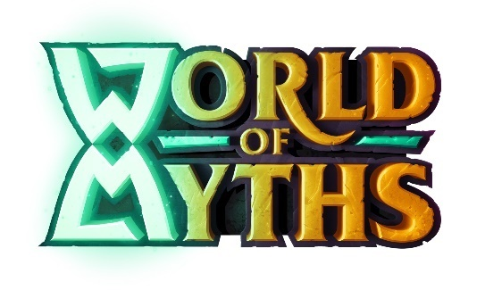


SoftUni Organizational Partners

Slide 32




Trainings @ Software University (SoftUni)
Software University – High-Quality Education and Employment Opportunities
softuni.bg
Software University Foundation
http://softuni.foundation/
Software University @ Facebook
facebook.com/SoftwareUniversity
Software University Forums
forum.softuni.bg

Slide 33

License
This course (slides, examples, demos, videos, homework, etc.) is licensed under the "Creative Commons Attribution-NonCommercial-ShareAlike 4.0 International" license

